Slide 2
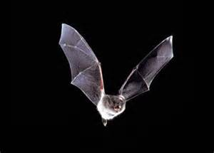
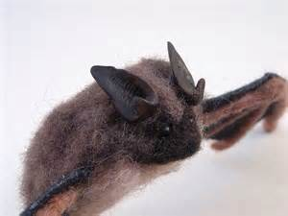
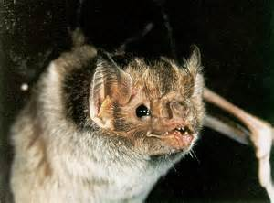
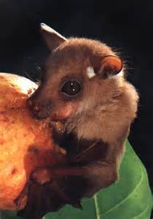
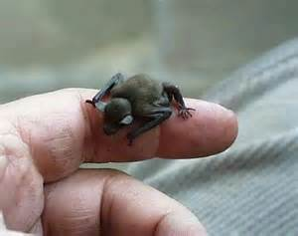
Did you know there are more than 1,200 different types of bats?!

Slide 3
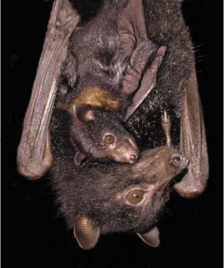
What is a bat?
A bat is a mammal !
Bats have fur.
Bats have live young (babies)
Bats are warm blooded. This means their body temperature stays the same even when it’s cold outside.
Bats get food from their mother’s milk.
Bats have lungs and need air to breathe.
Bats are the only mammals that can fly.

Slide 4
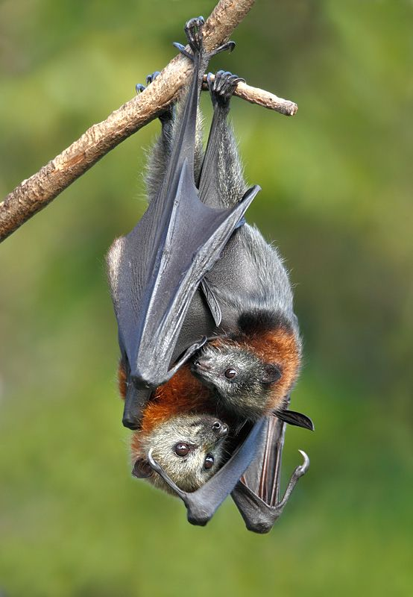
Bat Families
Bats live in large groups called colonies.
Mothers give birth to live babies. They are called pups. The pups stay feed from the mom bat’s milk for a month and then can hunt for food on their own.

Slide 5
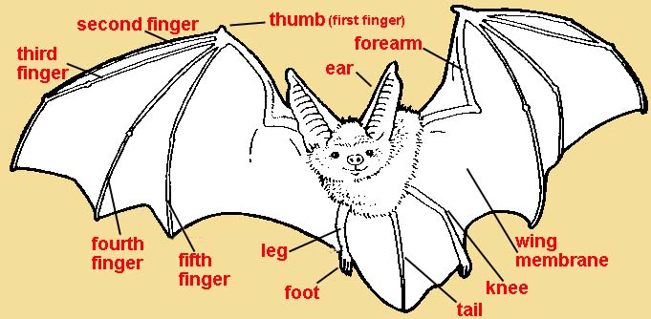
Bat Anatomy

Slide 6
What do bats eat?
Different bats have different diets!
Most bats eat bugs that fly, like moths and bugs on the ground, like crickets.
Some bats eat fruits like mangos and bananas.
Some bats drink blood from frogs, fish, and small animals.
Some bats eat small animals.
Bats also have to drink water to survive!
Watch this video of a bat catching a fish!

Slide 7
Echolocation
Bats are nocturnal. This means they are active at night. How do they know where food is? Echolocation! To learn more, watch this video and sing along! ☺

Slide 8
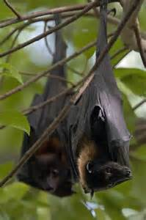
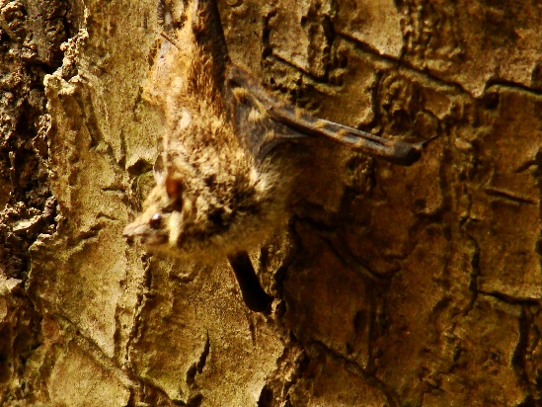
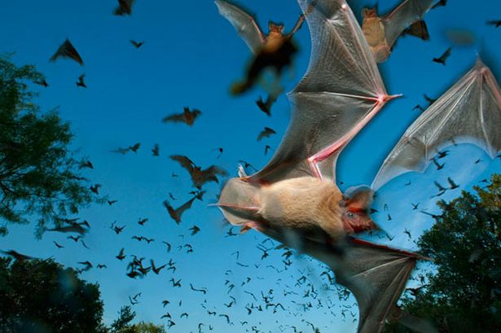
Bat Predators
Hawks and owls hunt for bats from the sky. Snakes, weasels, and raccoons are a bat’s ground predators.
Most bats live in caves, under bridges, or in trees with long branches full of leaves so they can stay hidden from predators.
Some bats use camouflage to protect themselves. They blend into their environments.
Bats are FAST! Most times they can fly away from predators or use their claws to defend themselves.

Slide 9
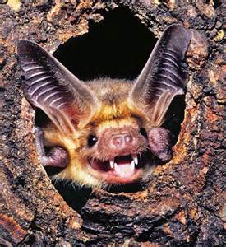
Where do bats live?
Bats’ homes are called roosts. Bats need different roosts for different times of year.
Most bats find a roost already made like holes in trees. They can’t make their own nests like birds do.
Bats need roosts to provide protection while they have their young.
In winter, bats need shelter from the cold.
Some bats find roosts in caves to hibernate. They go into a deep sleep, their heart rate slows, and they live off fat stored on their bodies.
Some bats migrate in the winter. This means they fly to warmer roosts.
Most bats go to the same roosts each season.

Slide 10
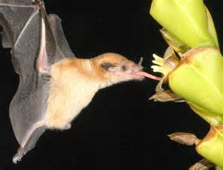
Bats are Good for the Environment!
What are some animals that pollenate flowers and help make new plants? Bees? Birds? Absolutely! Did you know that bats help new plants grow too?
Some bats eat nectar from flowers with long tongues and when they do this, they spread pollen. This creates new plants.
Some bats eat fruit and when they spit the seeds on the ground, they can create new plants.
Bats also protect plants by eating the insects that try to eat plants.

Slide 12
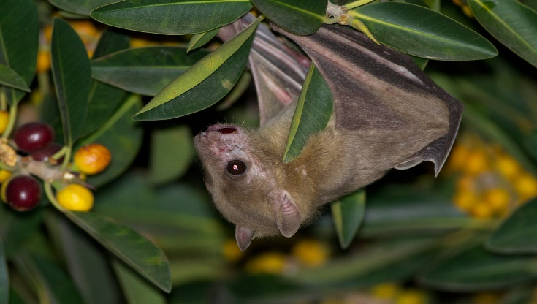
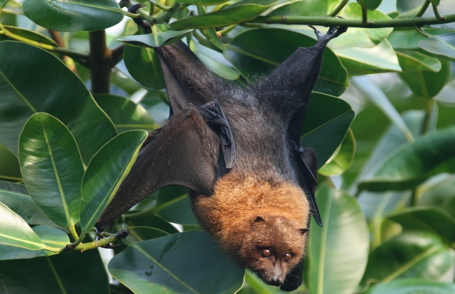
The Fruit Bat
The fruit bat is the largest bat in the world. It’s wing span can be 6 feet long! That’s longer than you.
Fruit bats eat nectar, pollen, and fruits.
Fruit bats do not have echolocation. They use their noses to smell where their food is.

Slide 13
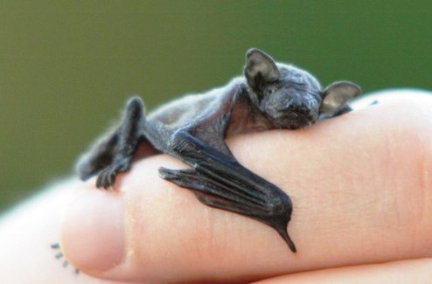
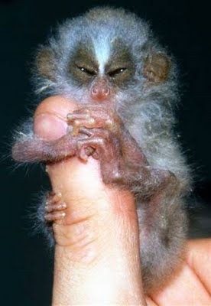
The Bumblebee Bat
Ahhhh, will this bat sting me? No way!
The bumblebee bat is the smallest bat in the world. It gets its name by being about the same size as a bumblebee.
Its body is only one inch long and its wingspan is 6 inches long, the size of half a ruler.
The bumblebee bat weighs the same as a dime.
This bat eats small insects like moths and flies.

Slide 14
The Little Brown Bat
The little brown bat is one of the most common bats.
It lives in swampy areas and eats mostly moths and wasps.
This bat is 2-4 inches long, like the size of your finger or hand. Its wingspan is 11 inches long, almost the size of a ruler.
Watch the video below to observe a Little Brown Bat!

Slide 16
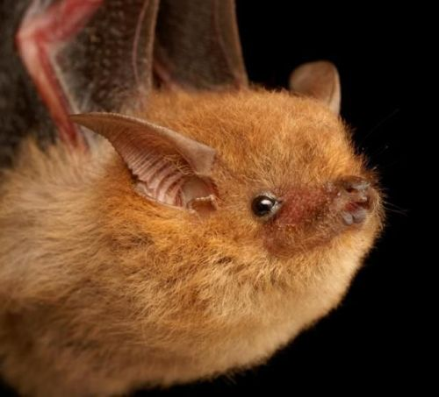
You have learned so much about bats! Want to learn more?
With adult permission, check out these bat sites! Just click on the links below.
Organization for Bat Conservation – bat facts website
Bat Worlds – bat facts website
eHow – Bat Facts for First Grade article
Sheppard Software – bat facts and fun quiz
Zuza Fun – cute bat photos
You can also find the locations of all pictures I used by clicking on them in the presentation.

